Slide 1


Modern Data Management & Business Intelligence
Assignment 2
Authors:
Christos Katsaris
Pavlos Polyzogopoulos

Slide 2



Introduction
Climate change
Correlation with weather
Climate change trend and the effect on every day life

Slide 3
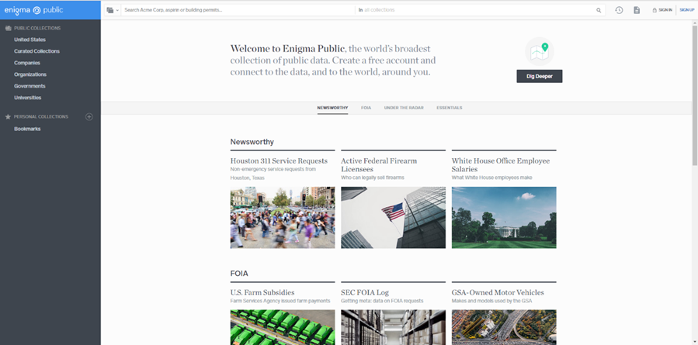
Datasource
Website Enigma Public the world’s broadest collection of public data.
https://public.enigma.com

Slide 4

Datasets
Data came from NOAA (National Oceanic Atmospheric Administration).

Slide 5
Datasets
Observations and records dated from 1800 - 2016

Slide 6
Database set up & ETL process
CSV file for every year (2012, 2008, 2004, 1998, 1988)
Import from SSMS with import flat file task
Merged table for all years and transformation of data types that were not valid during insert process
Dimension tables with cleaning unnecessary information
Fact table from joining merged all years table and dimension tables
Fact table approximately 22 M rows in total!!! (Big Data)

Slide 7
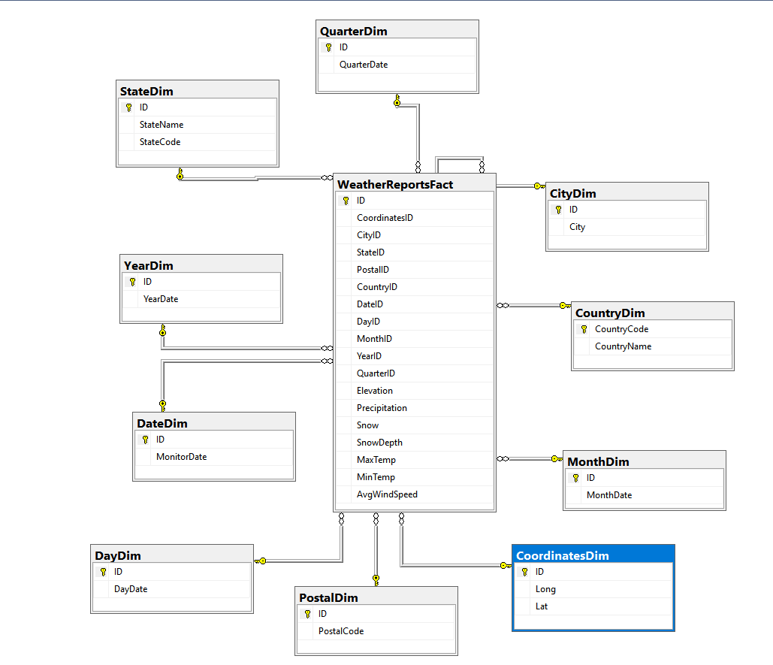
Database set up & ETL process
Creating connections between fact and dimension tables with foreign keys
Final star schema in database

Slide 8
Building the cube
New project in visual studio
Connecting to the database and creating the cube
Adding dimensions manually and converting to proper data types
Adding measures and new calculated members for more detailed analysis
Notes:
That was the process of cleaning the data sets and creating our data base and now we are ready to create our new project in SSAS.
First, we have to connect the SQL server with the SSAS.
Next we have to add dimensions and the measures from the star schema.
We changed the data type of some measures (specifically the dates) to make sure that all the calculations would be correct.
But also to help us in the visualizations in the tableau

Slide 9
Building the cube
Adding measures and new calculated members for more detailed analysis

Slide 10
Testing the cube
Checking and testing new calculated members with several dimensions in SSAS

Slide 11
Browsing the cube
More tests in Excel

Slide 12
Connecting to Tableau
Setting the connection with SSAS

Slide 13
Tableau Analysis
Creating and working with sets
Combining sets

Slide 14
Tableau Analysis
All countries are getting warmer except for Italy
Notes:
.

Slide 15
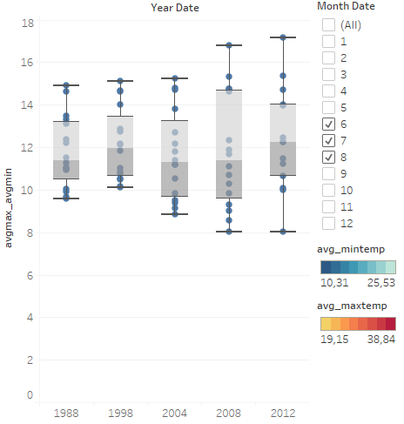
Tableau Analysis
Focusing in summer months
Notes:
.

Slide 16
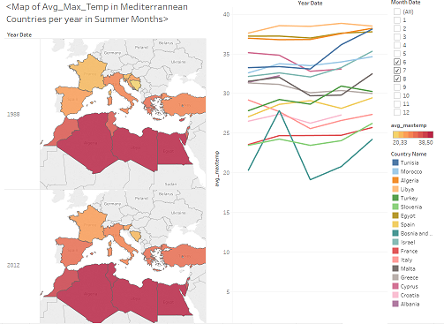
Tableau Analysis
All countries are getting warmer except Italy, Greece and Cyprus

Slide 17
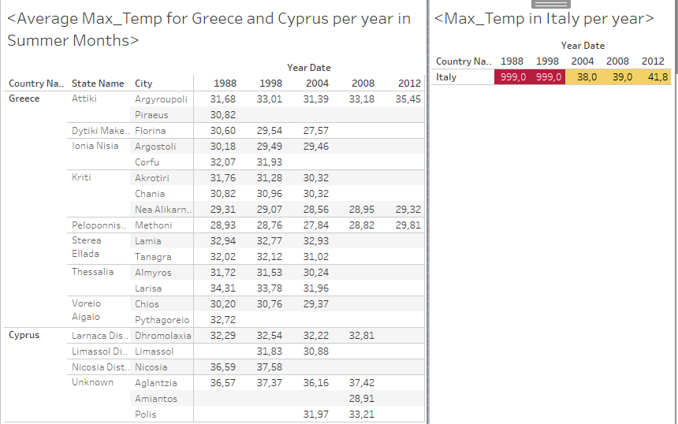
Tableau Analysis
Let’s see what’s going on
Notes:
.

Slide 18
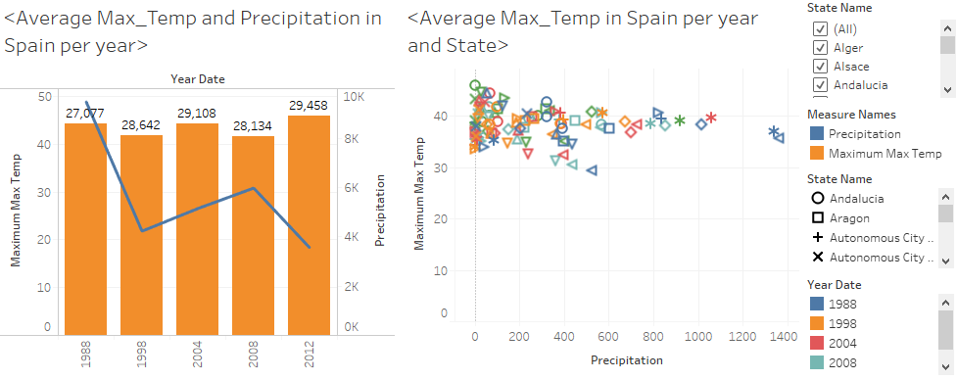
Tableau Analysis
Focus on Spain (Summer Months)
Notes:
.

Slide 19
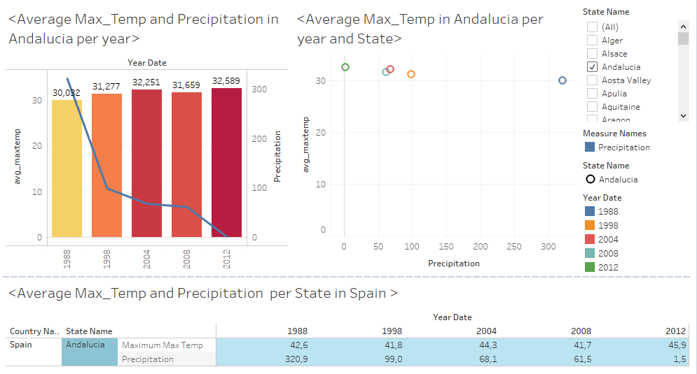
Tableau Analysis
The biggest change was noticed in Andalucía
Notes:
.

Slide 20
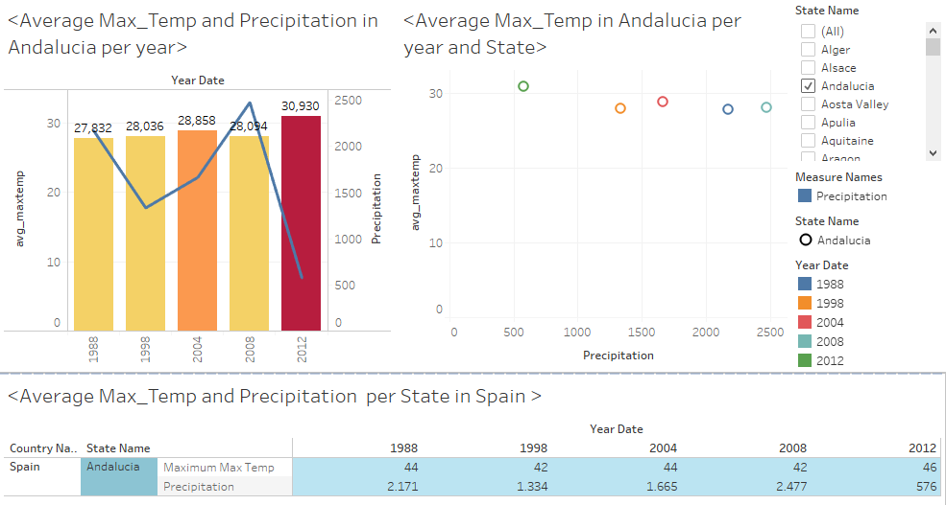
Tableau Analysis
Average Temperature and Precipitation in Andalucía (May – October)

Slide 21
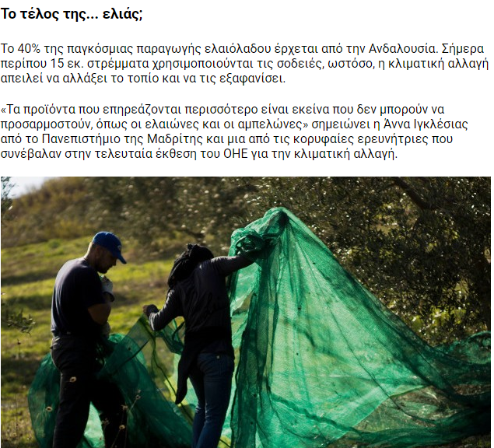
Conclusion
Several references online strongly indicate that there is a problem with the olive oil production due to climate change

Slide 22
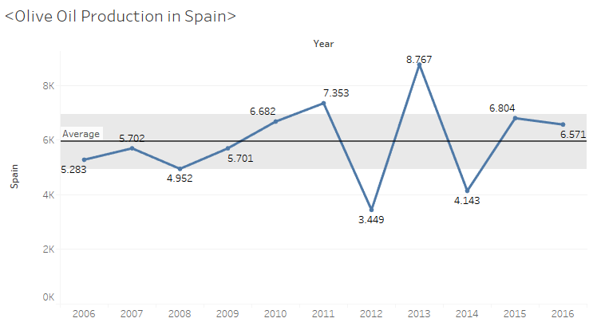
Conclusion
Olive Oil production hits lowest level in 2012
Source of Data: Eurostat

Slide 23
Conclusion
The analysis in our weather data proved that climate change does really occur in the Mediterranean countries.
After focusing on one country (Spain) our analysis led us in Andalusia and we noticed that there is a rise in the temperature and at the same time a drop in precipitation. By searching a little bit more on the issue of Andalusia we came up with the following.
Andalusia is the biggest olive oil producer in the world. What is more, the olive trees are affected by rapid weather changes and droughts. During the years that we performed our analysis, we found out that the olive oil production in Andalusia was affected negatively.
As we can see from the Andalusian example, the changes in weather that in the long run have an effect on the climate actually do affect people’s lives.

